Slide 1
Final Art Selections - November 12, 2019
(size in presentation reflects Art.com image size)
Facility:
Westerly Hospital Urology
Champion Building
35 Wells Street, 2nd Floor
Westerly, RI 02891
Client Contacts:
Annie Alevras, RN, BSN, CNOR
Patient Care Services Manager, Outpatient Urology
Phone: 860-271-4328
Cell Phone: 860-916-7063
Email: ann.alevras@lmhosp.org
Olga Tysh
Urology Operations Coordinator
Phone: 203-623-8850 Email: olga.tysh@ynhh.org

Slide 2
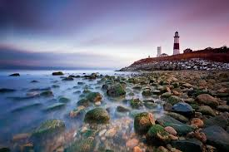
Westerly Hospital Urology – Champion Building
48273271201A, Nubble Sunset 24h x 36h
34H
48273274056A, Montauk Point Sunset
24h x 36h

Slide 3
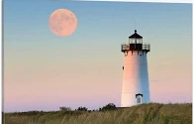
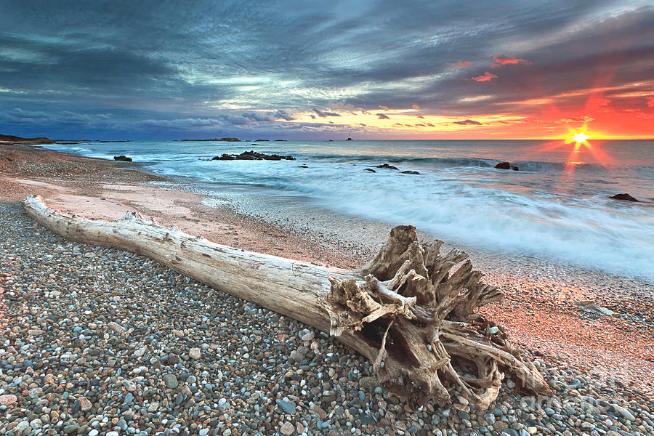
Westerly Hospital Urology – Champion Building
48273271203A
Moon Over Martha’s Vineyard
24h x 36h
48273274009A
Sakonnet Driftwood
24h x 36h

Slide 4
Westerly Hospital Urology – Champion Building
482926113871
Dunes Light
12h x 36w

Slide 5
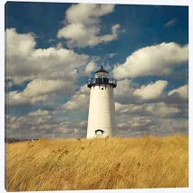
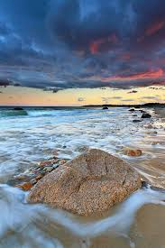
Westerly Hospital Urology – Champion Building
48273274145A
Autumn Light
30h x 24w
48273273862A
Squibnocket Sunset
36h x 24w

Slide 6
Picture That, LLC
Soundview Plaza 1266 East Main Street, Suite 700R Stamford, CT 06902
Phone: 203-977-8203
General Inquiries
fineart@picture-that.com
www.picturethatart.com

